Slide 1

Genome Browsers
ICG Tips and Tricks Series
February 8, 2022

Slide 2
Dalhousie University is located in Mi’kma’ki, the ancestral and unceded territory of the Mi’kmaq. We are all Treaty people.

Slide 3
Genome Browsers
A program/suite of programs to visually interact with a genome at varying levels of complexity

Slide 4
Genome Browsers
-two main flavours
-just for display
-publicly available data
-model organisms
-can often input new tracks
-Ensembl
-NCBI
-JGI
-all dressed
-can input new data
-your own genome
-can annotate

Slide 5
Things to consider when picking a genome browser
-speed
-depending on tracks there may be lots of data (BAM, VCF)
-will it be upgraded/maintained/around in 5 years
-GenomeView
-released in 2011
-last release N42 April 2018
-look for ones associated with large institutes
-IGV –Broad Institute -released 2011 –latest release 2.12.0 January 2022
-ARTEMIS –Sanger Centre –released 2000 –latest release 18.1 2019
-UCSC genome browser-UCSC genome institute –released 2000 –latest 2022
-ease of installation
-number and nature of dependencies
-Virtual Machine
-Java
-mysql
-databases
-web version

Slide 6
Things to consider when picking a genome browser continued
-ease of uploading and downloading data
-search abilities
-gene names
-gene ids
-key words
-genome positions
-sequence (nucleotide, amino acid)
-annotation
-changing the information associated with a feature
-changing the underlying consensus
-changing the gene structure (exons, stops, starts)
-output options
-gff, gbk, EMBL,fasta
-images (png, jpeg)
-links to other data
-sharing data with collaborators

Slide 7
Things to consider when picking a genome browser continued
-sequence display
-nucleotide bases
-amino acids
-6 frames
-blast capable
-sequences can be blasted

Slide 8
Add data
-usually called tracks
-some common file types
-GFF and its descendants (GFF2,GFF3,GTF)
-BED
-BAM
-VCF

Slide 9
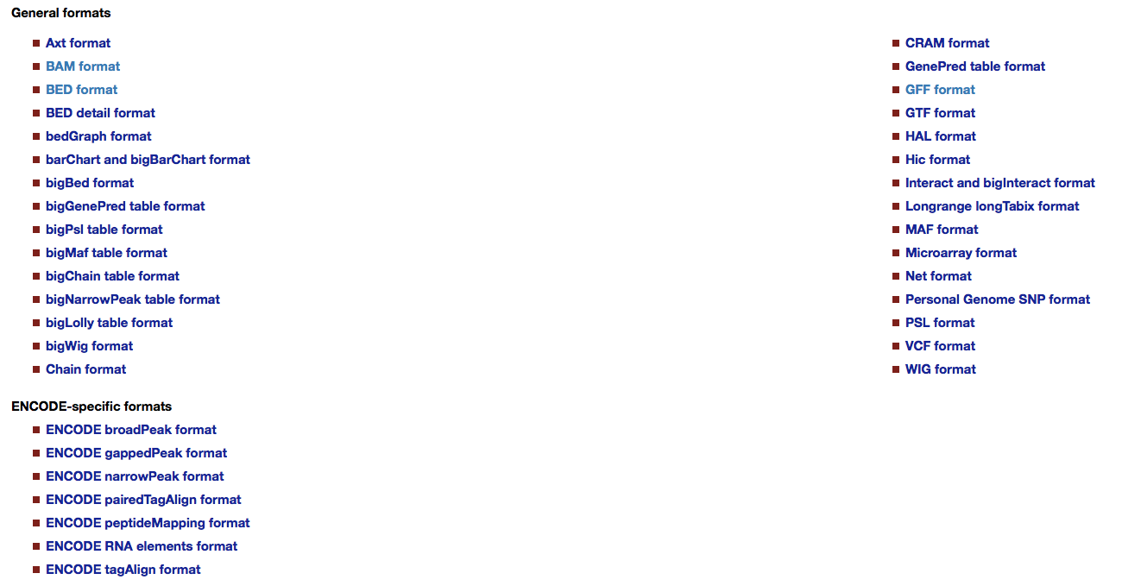

Slide 10
GFF (General/Generic Feature Format) https://github.com/The-Sequence-Ontology/Specifications/blob/master/gff3.md
-universal, ie can be read and incorporated by all genome browers?
-different flavors and versions
-easily parsed
-simple text file
-some programs to convert from one version to the other
-validators
-contains 9 tab delimited fields
1. name of the chromosome or contig eg. chr1, contig_34
2. source or name of the program that generated the data eg. PASA, Augustus
3. feature name, eg. gene, CDS, intron,exon,start,stop
4. start position of the feature (always less than or equal to end)
5. end position of the feature
6. score (often blank (.))
7. strand (+ for forward, - for reverse, . for non-stranded, ? for uknown)
8. frame/phase (0,1,2,.), often blank (.), only used for feature type CDS
9. attributes/group, can contains lots of different information
-hierarchical
-Parent, ID
1
2
3
4
5
6
7
8
9
Scaffold1000 Augustus gene 33 2671 0.0 - . ID=g2898.t1;product=Aspartyl protease; annotator=""; note="";

Slide 11
BED (browser extensible data)
-original developed for the human genome project
-most closely associated with UCSC Genome Browser
-does not have any official specifications but usually follow the UCSC format
-easily parsed
-minimum of 3 columns with 9 additional columns that can be added
1. name of the chromosome or contig eg. chr1, contig_34
2. feature start (NB. The first base in the chromosome is 0)
3. feature end
4. name of the type of data (eg. exons)
5. score between 0-1000) -level of gray for visual representation of the feature
6. strand (+,-,.)
7. thickStart -The starting position at which the feature is drawn thickly
8. thickEnd - The ending position at which the feature is drawn thickly
9. itemRgb – An RGB value for the color of the visual representation of the feature
10. blockCount - The number of blocks (exons) in the BED line
11. blockSizes - A comma-separated list of the block sizes. The number of items in this list should correspond to blockCount.
12. blockStarts - A comma-separated list of block starts The number of items in this list should correspond to blockCount.
1
2
3
4
5
6
7
8
9
10
11
12
chr22 1000 5000 cloneA 960 + 1000 5000 0 2 567,488, 0,3512

Slide 12
BAM (Binary Alignment Map)
-compressed binary version of SAM
-you can’t look at the contents (but you can in SAM format)
-used to store information about how reads map to the consensus sequence
-much smaller than SAM files (which can be huge)
-memory smart (only loads the portion you are looking at into memory)
-CRAM is more dense form of BAM
-tools to extract information from BAM/SAM files
-SAMTOOLS
http://samtools.sourceforge.net

Slide 13
VCF (variant call format)
-developed by the 1000 Genomes Project
-flexible, extendable line-oriented text format
-variants
-SNPs, indels, copy number variants, structural variants
-usually used in a compressed and indexed format
-easily gunzipped
-dense, with lots of obscure fields
-header information provides some guidance to the different fields
##INFO=<ID=AF,Number=A,Type=Float,Description="Allele Frequency">
-tools to extract/manipulate vcf files
https://vcftools.github.io/index.html
20 1110696 rs6040355 A G,T 67 PASS NS=2;DP=10;AF=0.333,0.667;AA=T;DB GT:GQ:DP:HQ 1|2:21:6:23,27 2|1:2:0:18,2 2/2:35:4

Slide 14
Genome Browsers
Widely used ones
Artemis http://sanger-pathogens.github.io/Artemis/Artemis/
IGV https://software.broadinstitute.org/software/igv/
UCSC genome browser https://genome.ucsc.edu
Geneious https://www.geneious.com (commercial/expensive/booo/hiss)
Others (use at your own risk)
Genomeview http://genomeview.org
CRAMER https://github.com/FadyMohareb/cramer
Genoverse http://wtsi-web.github.io/Genoverse/

Slide 15
Artemis http://sanger-pathogens.github.io/Artemis/
-has been around a long time
-looks a little old fashioned
-doesn’t handle multifasta files very well
-coordinates lost
-load individual contigs/scaffolds
-limited input/output options/formats
-can alter the underlying consensus
-can use your own data
-detailed manual

Slide 16
UCSC genome browser https://genome.ucsc.edu
-large number of publicly available genomes
-extensive collection of data associated with the genomes
-extensive documentation
-large number of input/output options/formats
-has been around for years and not likely to disappear anytime soon
-can share and collaborate
-really designed for publicly available/model organism genomes
-can be used with “private” genome data in assembly hubs
-data stored at UCSC
-not private
-can slow things down
-can get a locally installed genome browser in a box (https://genome.ucsc.edu/goldenpath/help/gbib.html)
-interface is a little clunky
-sometimes too much data for publicly available genomes

Slide 17
IGV https://software.broadinstitute.org/software/igv/
-can share genome on the web
-documentation is a little concise
-fast
-supports lots of input formats
-can import your own genome
-cannot annotate, ie cannot make changes to gene structures, gene information
-has common model organism assemblies for import
-page with instructions does not work (you are not authorized to access this page)

Slide 18
Recommendations
Offsite collaboration
-just viewing
IGV
-annotation
-UCSC
Annotation (single user)
-Artemis
-GenomeView
-Geneious (sigh)
Just Viewing
-IGV
-Artemis
-GenomeView
-Geneious (sigh)

Slide 19
Questions?
I invite you to attend the next ICG journal club Feb 22
Next Tips and Tricks – March 8th exploring read depth and coverage
A recording of this session will be available from
https://perun.biochem.dal.ca/downloads/icgvideo/TAT/
A copy of this presentation will be available from
https://perun.biochem.dal.ca/user-wiki/doku.php?id=start

