Slide 1
tips and tricks graphics with R
An introduction to R by Alex Douglas, Deon Roos, Francesca Mancini, Ana Couto, & David Lusseau

Slide 2
3 main approaches for producing graphics in R
base R graphics
original plotting system
allows for lots of customization
lattice graphics
no distinction between plotting and annotating plot (much is automatic)
shines at plotting complex multidimensional data using panels
ggplot2
automatically makes many choices for you but you can still customize by “adding” to a plot

Slide 3
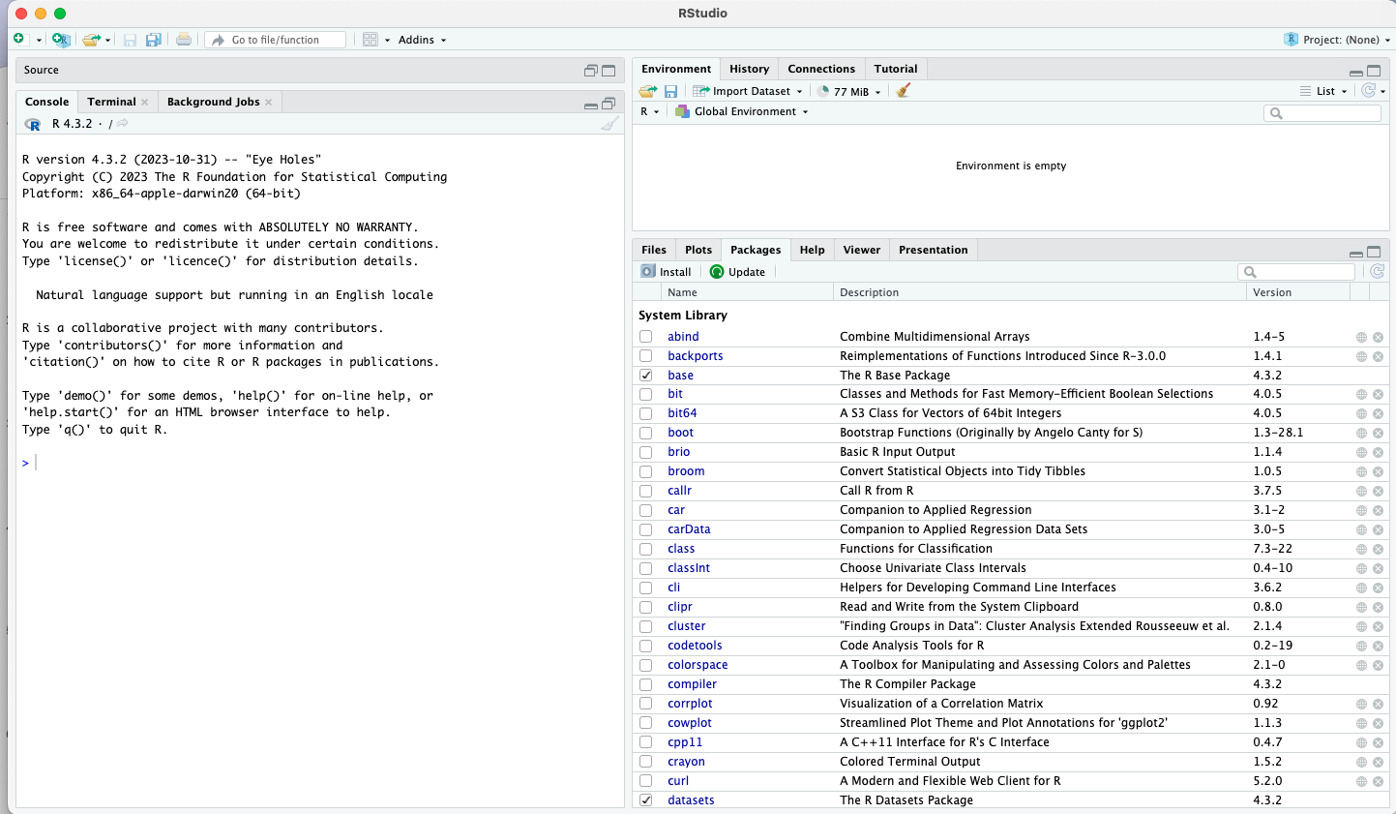
R studio

Slide 4
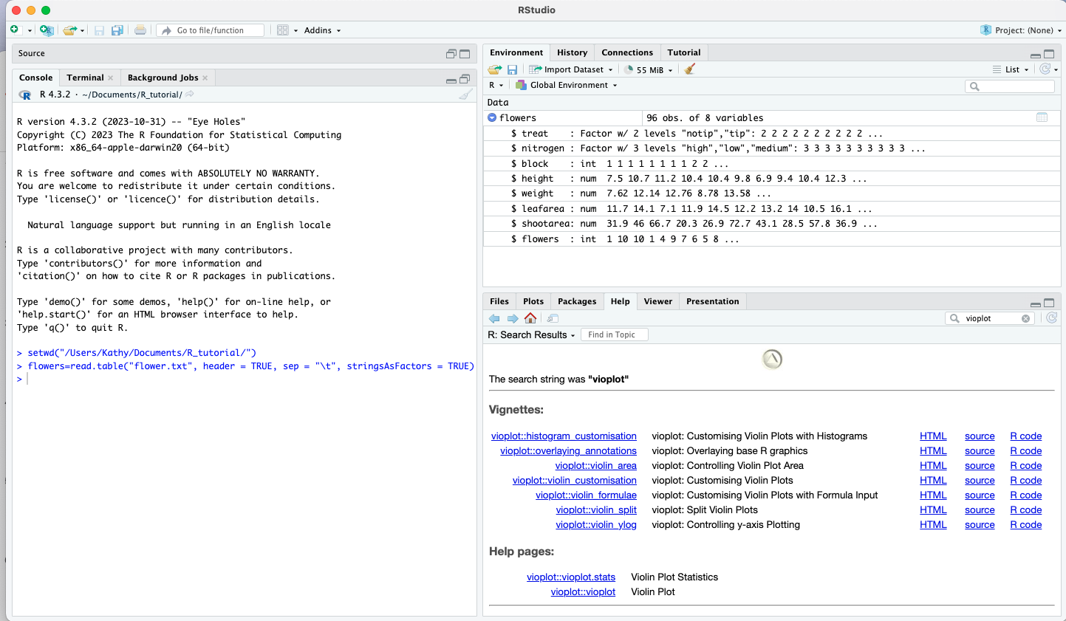
Notes:
results of an experiment to determine the effects of removing the tip of petunia plants grown at 3 levels of nitrogen on various measures of growth
effect of removing the tip of petunia (Petunia sp.) plants grown at 3 levels of nitrogen on various measures of growth. The dataframe has 8 variables (columns) and each row represents an individual plant. The variables ‘tip treatment’ and ‘nitrogen level’ are categorical and ‘shoot height’, ‘shoot weight’, ‘leaf area’, ‘side shoot area’ and ‘flower number’ are continuous. Although the variable ‘block’ has numerical values, these do not have an order (the plants were either grown in block 1 or block 2 which have no order) and could also be treated as categorical

Slide 5
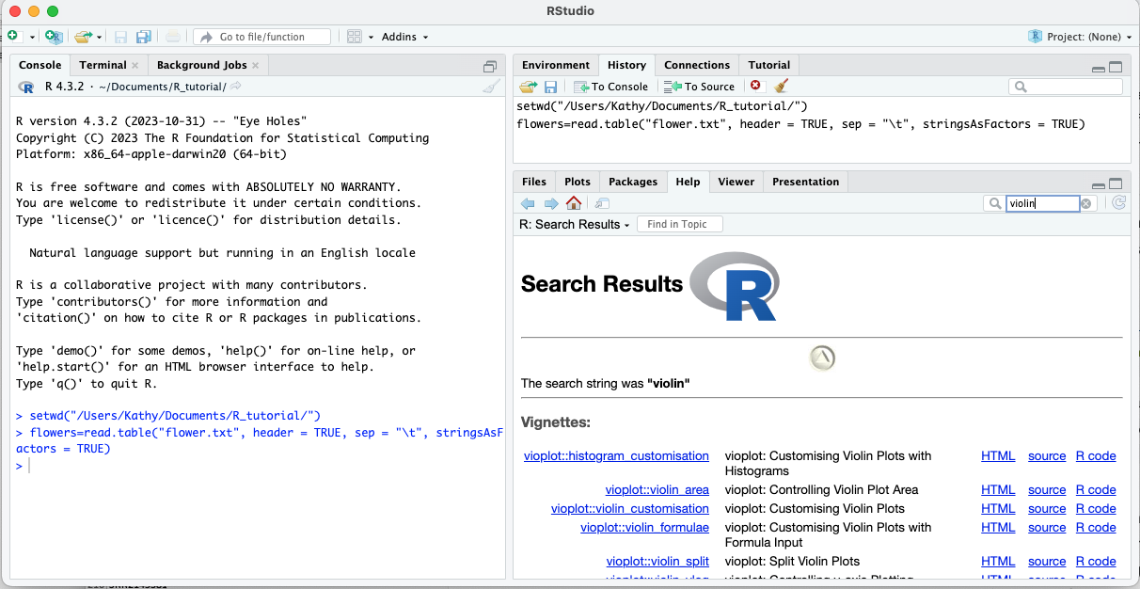

Slide 6
Base R graphics
start with a plot function to create the plot
e.g. plot( ), hist( ), boxplot( ), vioplot( )
add additional information using annotation functions
e.g. lines( ), text( ), points( ), legends( )
allows for lots of customization
shape and color of points
location of legend
name, color, presence of axes
orientation, size, presence of tick marks

Slide 7
Base R plot functions
plot() – scatterplots
hist() – histograms
boxplot() – boxplots
vioplot() – violin plots*
pairs() – matrix scatterplots
coplot() – conditioning plots

Slide 8
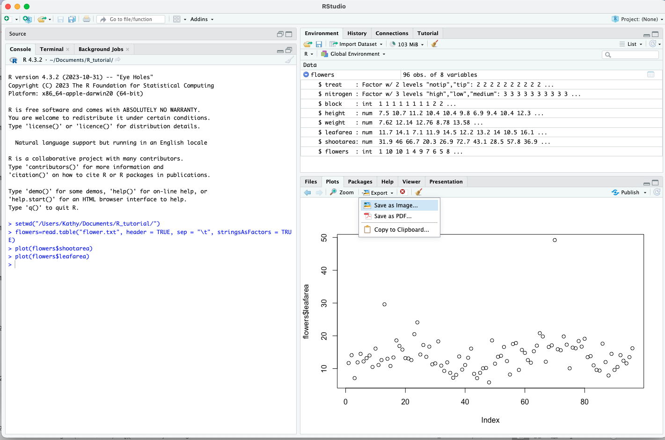
Scatterplot with one variable plot(flowers$leafarea)

Slide 9
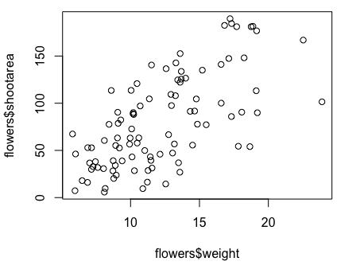
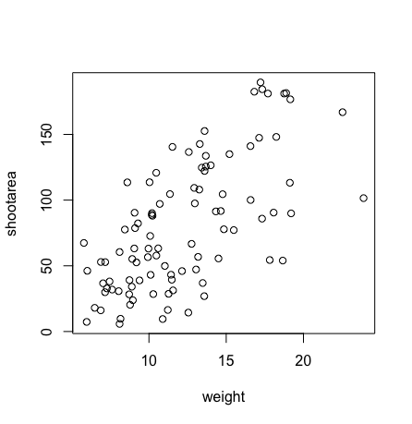
Scatter plots plot() function
plot(x=flowers$weight, y=flowers$shootarea)
plot(flowers$shootarea ~ flowers$weight)
plot(shootarea~weight, data=flowers)
with(flowers, plot(weight, shootarea))

Slide 10
Histograms hist() function – frequency histogram
hist(flowers$height)
Notes:
Note that it uses Sturges formula to determine break points (derived from binomial distribution and implicitly assumes an approximate normal distribution)

Slide 11
Histograms hist() function
breaks were created automatically to bin the data
you can also specify the breaks
breaks= seq(from = value, to = value, by = “increment by”)
brk = seq(from=0, to=20, by = 1)
hist(flowers$height, breaks=brk)
Notes:
Note that it uses Sturges formula to determine break points (derived from binomial distribution and implicitly assumes an approximate normal distribution)
autobin performs poorly if n<30 and can overestimate bin width for very large datasets (oversmoothed)

Slide 12
boxplot() function - single variable
boxplot(flowers$weight)
whiskers
75th quartile
median
IQR
25th quartile

Slide 13
boxplot() function – between groups
groups (factors)
boxplot(weight ~ nitrogen, data=flowers)
plotted in order defined by factor variable - by default alphabetical

Slide 14
flowers data
96 entries and 8 variables
str(flowers)
'data.frame': 96 obs. of 8 variables:
$ treat : Factor w/ 2 levels "notip","tip": 2 2 2 2 2 2 2 2 2 2 ...
$ nitrogen : Factor w/ 3 levels "high","low","medium": 3 3 3 3 3 3 3 3 3 3 ...
$ block : int 1 1 1 1 1 1 1 1 2 2 ...
$ height : num 7.5 10.7 11.2 10.4 10.4 9.8 6.9 9.4 10.4 12.3 ...
$ weight : num 7.62 12.14 12.76 8.78 13.58 ...
$ leafarea : num 11.7 14.1 7.1 11.9 14.5 12.2 13.2 14 10.5 16.1 ...
$ shootarea: num 31.9 46 66.7 20.3 26.9 72.7 43.1 28.5 57.8 36.9 ...
$ flowers : int 1 10 10 1 4 9 7 6 5 8 ...

Slide 15
boxplot() function – between groups
flowers$nitrogen = factor(flowers$nitrogen,
levels = c(“low”, “medium”, ”high”))
boxplot(weight~nitrogen, data=flowers)

Slide 16
boxplot() function – between groups
can group variables by two factors in the same plot
boxplot(shootarea ~ nitrogen*treat, data=flowers)

Slide 17
violin plots - vioplot() function
requires special package vioplot
install.packages("vioplot")
library(vioplot)
vioplot(weight ~ nitrogen, data=flowers)
Notes:
boxplot and kernel density in one, white dot is median

Slide 18
scatterplot matrix plot - pairs() function
creates a multi-panel plot of all combinations of variables
pairs(data[, c(“var1”, “var2”, “var3”, ”var4”, ”var5”)])
pairs(flowers[, c("height", "weight", "leafarea", "shootarea", "flowers")])
'data.frame': 96 obs. of 8 variables:
$ treat : Factor w/ 2 levels "notip","tip": 2 2 2 2 2 2 2 2 2 2 ...
$ nitrogen : Factor w/ 3 levels "high","low","medium": 3 3 3 3 3 3 3 3 3 3 ...
$ block : int 1 1 1 1 1 1 1 1 2 2 ...
$ height : num 7.5 10.7 11.2 10.4 10.4 9.8 6.9 9.4 10.4 12.3 ...
$ weight : num 7.62 12.14 12.76 8.78 13.58 ...
$ leafarea : num 11.7 14.1 7.1 11.9 14.5 12.2 13.2 14 10.5 16.1 ...
$ shootarea: num 31.9 46 66.7 20.3 26.9 72.7 43.1 28.5 57.8 36.9 ...
$ flowers : int 1 10 10 1 4 9 7 6 5 8 ...

Slide 19
pairs(flowers[, c("height", "weight", "leafarea", "shootarea", "flowers")])

Slide 20
coplot( )
-Examine relationships between numeric variables examining if a third variable could be obscuring or changing the relationship.
coplot(height ~ weight | leafarea, data=flowers)
overlap = 0

Slide 21
coplot( )
-Examine if relationship of variables are conditioned on other factor(s)
coplot(flowers ~ weight | nitrogen, data = flowers)
coplot(flowers ~ weight | nitrogen*treat, data = flowers)

Slide 22
plot(flowers$flowers ~ flowers$weight)

Slide 23
customization within plot functions - labels
add labels to x- and y- axis
xlab= “ ” and ylab= “ ”
add a title
main= “ ”
size of labels /title
cex.lab = and cex.main= number (magnification or shrinkage)
font style (1:normal, 2: bold, 3: italics, 4:bold italics)
font.lab = , and font.main =
plot(x=flowers$weight, y=flowers$flowers,
xlab= “weight (g)” , ylab=“counts of flowers”,
main = “Plot of numbers of Petunia flowers\nby shoot weight”, cex.lab = 1.2, font.lab=3, cex.main= 2, font.main=4)
Notes:
cex = character extension

Slide 24
Notes:
don’t like that points near edge, or that x and y don’t go to zero. and it would be nicer if I didn’t have the lines on top or right

Slide 25
customization within plot functions
adjust x and y range
xlim= and ylim = set with c(min, max)
adjust box type around plot
bty = (“o”, “l” , “n” , “u”) default= “o”
(4-sides, bottom & left, none, bottom left & right)
plot(x=flowers$weight, y=flowers$flowers,
xlab= “weight (g)” , ylab=“counts of flowers”,
xlim = c(0,25), ylim = c(0,20), bty = “l”)

Slide 26
Notes:
would be nice if labels on y axis were oriented differently

Slide 27
customization within plot functions tick marks
adjust label orientation on tick marks (default = 0; parallel)
las = (0, 1, 2, 3)
Parallel
Horizontal
Perpendicular
Vertical

Slide 28
customization within plot functions tick marks
adjust size of labels on tick marks
cex.axis = number (magnification or shrinkage)

Slide 29
customization within plot functions
x and y axis to meet at 0 xaxs= "i"and yaxs= "i"
plot(x=flowers$weight, y=flowers$flowers, xlab= "weight (g)" , ylab="counts of flowers", main = "Plot of numbers of Petunia flowers\nby shoot weight", cex.lab = 1.2, font.lab=3, cex.main= 2, font.main=4, xlim = c(0,25), ylim = c(0,20), bty = "l", las=1, cex.axis=1.2, xaxs= "i", yaxs= "i")
Notes:
size of tick mark can also be changed

Slide 30
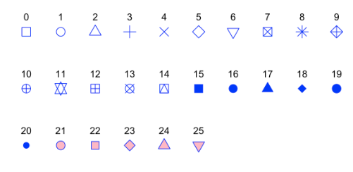
customization within plot functions - symbols
change symbol
pch = number (default is 1)
adjust color of symbol
col = (number or “color”)
bg = (number or “color”)
colors( ) will list all 657 preset colors
adjust size of symbol
cex = magnification or shrinkage
adjust line thickness
lwd=magnification or shrinkage

Slide 31
plot(x=flowers$weight, y=flowers$flowers, …, cex=1.2, col=flowers$nitrogen, pch=17)
plot(x=flowers$weight, y=flowers$flowers, …, cex=1.2, col="red", bg="blue", pch=21)

Slide 32
Base R graphics
start with a plot function to create the plot
e.g. plot( ), hist( ), boxplot( ), vioplot( )
add additional information using annotation functions
e.g. lines( ), abline( ), text( ), legend( ), points( ), axis( )

Slide 33
lines() function to add density curve
add kernel density curve to histogram plot
hist(flowers$height, breaks = brk, freq = FALSE)
lines(density(flowers$height))
Notes:
histogram as proportion rather than frequency using freq=FALSE

Slide 34
abline() function to add one or more straight lines
abline(a=intercept, b=slope,
h=y-value for horizontal lines,
v= x-values for vertictal lines, col=, lty= …)
lty= sets type of line
1=solid; 2=dashed; 3=dotted; 4=dotdash; 5=longdash; 6=2dashes; 0=noline
plot(x=flowers$weight, y=flowers$flowers, xlab= "weight (g)" , ylab="counts of flowers", main = "Plot of numbers of Petunia flowers\nby shoot weight", pch=15,cex.lab = 1.2, font.lab=3, cex.main= 2, font.main=4, xlim = c(0,25), ylim = c(0,20), bty = "l", las=1, cex.axis=1.2, xaxs= "i", yaxs= "i”, col=flower$nitrogen)
Notes:
lty state of line 1 = default , 2=dashed, 3=dotted, 4=dash dot;

Slide 35
abline(h=mean(flowers$flowers), col="grey", lty = 2)
abline(v=mean(flowers$weight), lty=3)
abline(lm(flowers$flowers~flowers$weight), col="red")

Slide 36
text( )
text(x=3, y=mean(flowers$flowers), labels=paste("Mean flower count =", round(mean(flowers$flowers),2)), pos=3)

Slide 37
update - font
par(family=“font name”)
e.g.,
par(family=“times”) will set the font to times

Slide 38
update text placement using locator(1)
If you are using Rstudio you can click on the location in the plot you want the text to go by adding locator(1) where x, y is normally declared
e.g.
plot(x,y….)
text(locator(1), “text you are going to enter”)
after executing these two lines you can simply click on the plot where you want the text to appear and it will place it there

Slide 39
legend()
legend(x=2.5, y=19, pch= 15, col = c("black", "red", "green"), legend= c("low", "medium", "high"), title = "Nitrogen level", bty="n")
text(x=-2.5, y=22.5, labels=“A”, cex=2, xpd=“NA”)

Slide 40
plot(x=flowers$weight, y=flowers$flowers,
xlab= "weight (g)", ylab="counts of flowers", main = "Plot of numbers of Petunia flowers\nby shoot weight", cex.lab = 1.2, font.lab=3,
cex.main= 2, font.main=4, pch=15, xlim = c(0,25),
ylim = c(0,20), bty = "l", las=1, cex.axis=1.2, xaxs= "i", yaxs= "i")

Slide 41
global graphics parameters
par( ) function specifies the global graphics parameters that affect all plots in an R session
par(cex.lab = 1.2, font.lab=3, cex.main= 2, font.main=4, bty = "l", pch=15, las=1, cex.axis=1.2, xaxs= "i", yaxs= "i”, … col=“blue”)
-all plots called after will use parameters specified in par() function
-can be changed within any plotting function by reassigning the value
plot(x=flowers$weight, y=flowers$flowers, …,pch=0)
Notes:
These parameters can be overridden when they are specified as arguments to specific plotting functions.

Slide 42
global graphics parameters
par( ) function
multiframe plot layout
mfrow: plots per row and column (plots are filled row-wise)
mfrow=c(rows, columns) default is (1,1)
mfcol: plots per row, column (plots are filled column-wise)
mfcol=c(rows, columns) default is (1,1)
Notes:
These parameters can be overridden when they are specified as arguments to specific plotting functions.
multiframe rowwise layout

Slide 43
par( ) multiple plot layout
par(mfrow =c(2,2)) -call 4 plotting functions
par(mfcol =c(2,2)) -call 4 plotting functions

Slide 45
global graphics parameters
setting margins
mar defines plotting margins
default mar = c(5.1, 4.1, 4.1, 2.1)
oma defines outer margin
default oma = c(0, 0, 0,0)
par(mar=c(5, 4.9, 4, 2), mfrow = c(2,2), xaxs="i", yaxs="i”, bty="l", las=1, cex.axis = 1.2, pch=15)
order of values = (bottom, left, top, right)

Slide 47
see notes section below for actual code
Notes:
par(mfrow=c(2,2), bty="l", las=1, cex.axis = 1.2, xaxs="i", yaxs="i", cex.lab=1.2, mar=c(5, 4.9, 4, 2))
plot(x=flowers$weight, y=flowers$shootarea, xlab="weight (g)", ylab = expression(paste("shoot area (cm"^"2",")")),main="shoot area by weight", xlim=c(0,25), ylim=c(0,200), col=flowers$nitrogen, cex=1.2, pch=15)
text(x=-3, y=250, label="A", xpd="NA", cex=2)
abline(lm(flowers$shootarea ~ flowers$weight), col="grey")
clip(min(flowers$weight[flowers$nitrogen=="low"]), max(flowers$weight[flowers$nitrogen=="low"]), min(flowers$shootarea[flowers$nitrogen=="low"]), max(flowers$shootarea[flowers$nitrogen=="low"]))
abline(lm(flowers$shootarea[flowers$nitrogen=="low"]~flowers$weight[flowers$nitrogen=="low"]), col="black")
clip(min(flowers$weight[flowers$nitrogen=="medium"]), max(flowers$weight[flowers$nitrogen=="medium"]), min(flowers$shootarea[flowers$nitrogen=="medium"]), max(flowers$shootarea[flowers$nitrogen=="medium"]))
abline(lm(flowers$shootarea[flowers$nitrogen=="medium"]~flowers$weight[flowers$nitrogen=="medium"]), col="red")
clip(min(flowers$weight[flowers$nitrogen=="high"]), max(flowers$weight[flowers$nitrogen=="high"]), min(flowers$shootarea[flowers$nitrogen=="high"]), max(flowers$shootarea[flowers$nitrogen=="high"]))
abline(lm(flowers$shootarea[flowers$nitrogen=="high"]~flowers$weight[flowers$nitrogen=="high"]), col="green")
plot(x=flowers$height, y=flowers$shootarea, xlab="height (cm)", ylab = expression(paste("shoot area (cm"^"2",")")),main="shoot area by height", xlim=c(0,20), ylim=c(0,200), col=flowers$nitrogen, cex=1.2, pch=15)
text(x=-3, y=250, label="B", xpd="NA", cex=2)
abline(lm(flowers$shootarea ~ flowers$height), col="grey")
clip(min(flowers$height[flowers$nitrogen=="low"]), max(flowers$height[flowers$nitrogen=="low"]), min(flowers$shootarea[flowers$nitrogen=="low"]), max(flowers$shootarea[flowers$nitrogen=="low"]))
abline(lm(flowers$shootarea[flowers$nitrogen=="low"]~flowers$height[flowers$nitrogen=="low"]), col="black")
clip(min(flowers$height[flowers$nitrogen=="medium"]), max(flowers$height[flowers$nitrogen=="medium"]), min(flowers$shootarea[flowers$nitrogen=="medium"]), max(flowers$shootarea[flowers$nitrogen=="medium"]))
abline(lm(flowers$shootarea[flowers$nitrogen=="medium"]~flowers$height[flowers$nitrogen=="medium"]), col="red")
clip(min(flowers$height[flowers$nitrogen=="high"]), max(flowers$height[flowers$nitrogen=="high"]), min(flowers$shootarea[flowers$nitrogen=="high"]), max(flowers$shootarea[flowers$nitrogen=="high"]))
abline(lm(flowers$shootarea[flowers$nitrogen=="high"]~flowers$height[flowers$nitrogen=="high"]), col="green")
plot(x=flowers$flowers, y=flowers$shootarea, xlab="flower count", ylab = expression(paste("shoot area (cm"^"2",")")),main="shoot area by flower count", xlim=c(0,20), ylim=c(0,200), col=flowers$nitrogen, cex=1.2, pch=15)
text(x=-3, y=250, label="C", xpd="NA", cex=2)
abline(lm(flowers$shootarea ~ flowers$flowers), col="grey")
clip(min(flowers$flowers[flowers$nitrogen=="low"]), max(flowers$flowers[flowers$nitrogen=="low"]), min(flowers$shootarea[flowers$nitrogen=="low"]), max(flowers$shootarea[flowers$nitrogen=="low"]))
abline(lm(flowers$shootarea[flowers$nitrogen=="low"]~flowers$flowers[flowers$nitrogen=="low"]), col="black")
clip(min(flowers$flowers[flowers$nitrogen=="medium"]), max(flowers$flowers[flowers$nitrogen=="medium"]), min(flowers$shootarea[flowers$nitrogen=="medium"]), max(flowers$shootarea[flowers$nitrogen=="medium"]))
abline(lm(flowers$shootarea[flowers$nitrogen=="medium"]~flowers$flowers[flowers$nitrogen=="medium"]), col="red")
clip(min(flowers$flowers[flowers$nitrogen=="high"]), max(flowers$flowers[flowers$nitrogen=="high"]), min(flowers$shootarea[flowers$nitrogen=="high"]), max(flowers$shootarea[flowers$nitrogen=="high"]))
abline(lm(flowers$shootarea[flowers$nitrogen=="high"]~flowers$flowers[flowers$nitrogen=="high"]), col="green")
plot(x=flowers$leafarea, y=flowers$shootarea,, xlab=expression(paste("leaf area (cm"^"2",")")), ylab = expression(paste("shoot area (cm"^"2",")")),main="shoot area by leaf area", xlim=c(0,50), ylim=c(0,200), col=flowers$nitrogen, cex=1.2, pch=15)
text(x=-7, y=250, label="D", xpd="NA", cex=2)
abline(lm(flowers$shootarea ~ flowers$leafarea), col="grey")
clip(min(flowers$leafarea[flowers$nitrogen=="low"]), max(flowers$leafarea[flowers$nitrogen=="low"]), min(flowers$shootarea[flowers$nitrogen=="low"]), max(flowers$shootarea[flowers$nitrogen=="low"]))
abline(lm(flowers$shootarea[flowers$nitrogen=="low"]~flowers$leafarea[flowers$nitrogen=="low"]), col="black")
clip(min(flowers$leafarea[flowers$nitrogen=="medium"]), max(flowers$leafarea[flowers$nitrogen=="medium"]), min(flowers$shootarea[flowers$nitrogen=="medium"]), max(flowers$shootarea[flowers$nitrogen=="medium"]))
abline(lm(flowers$shootarea[flowers$nitrogen=="medium"]~flowers$leafarea[flowers$nitrogen=="medium"]), col="red")
clip(min(flowers$leafarea[flowers$nitrogen=="high"]), max(flowers$leafarea[flowers$nitrogen=="high"]), min(flowers$shootarea[flowers$nitrogen=="high"]), max(flowers$shootarea[flowers$nitrogen=="high"]))
abline(lm(flowers$shootarea[flowers$nitrogen=="high"]~flowers$leafarea[flowers$nitrogen=="high"]), col="green")
legend(x=40, y=100, pch= 15, col = c("black", "red", "green"), legend= c("low", "medium", "high"), title = "Nitrogen level", bty="n", xpd="NA")

Slide 48
Exporting plots
pdf(file=“directory/filename.pdf”, height=8 width=11)
… call plotting functions and amendment functions
dev.off()
png, tiff, jpeg, bmp can also be used
resolution, background color, and point size can also be adjusted
tiff also allows you to set compression

