Slide 1

Assembling RNA-Seq data
ICG Tips and Tricks Series
November 30, 2021

Slide 2
Dalhousie University is located in Mi’kma’ki, the ancestral and unceded territory of the Mi’kmaq. We are all Treaty people.

Slide 3
Types of RNA-seq data
Single gene (16S/18S/etc)
Exome
https://github.com/LangilleLab/microbiome_helper/wiki
Single cell
Total RNA from a single species
Total RNA from an assemblage of organisms

Slide 4
Strategies for RNA-seq assembly
De novo assembly
-can be done for all data sets
-even if a reference genome might be preferable
-genome sequence might not be complete
Reference based assembly
-need to have a genome
-map the reads to the genome sequence
-usually more accurate than de novo assembly
Combine the two sets
-overlaps (100 %)
-differences (less than 100%)
-missing from the other

Slide 5
KEEP IN MIND
You will want to do multiple assemblies
-different parameters
-subsets of the data
Computational Effort( or how many cups of coffee before I get my results)
-de novo assembly requires a lot of memory (RAM)
-use the maximum available
-for some of the assemblies you may want to restrict the data

Slide 6
Software available for assembling RNA-seq data (not exhaustive)
Oases
Soapdenovo-trans
TransABYSS
Trinity
Spades-sc
Spades-rna
Bridger
IDBA-Tran
BinPacker
Shannon
Tophat/cufflinks
Mira
TransComb
TransBorrow
StringTie
Bayesembler
Traph
iPac
A recent evaluation of De novo transcriptome assembly software (May 2019)
-setup ease
-usage
-runtime
-memory requirements
-mapping rate
-BUSCO
https://academic.oup.com/gigascience/article/8/5/giz039/5488105?login=true

Slide 7
Strand specific RNA-seq data
-more recent RNA-seq sequencing data is strand specific
-older data may not be
-usually a strand aware assembler will yield better results
-more transcripts
-not always clear what the direction/arrangement of the reads is
-different assemblers have different definitions (check documentation)
-for Trinity usually RF (dUTP/UDG protocol)

Slide 8
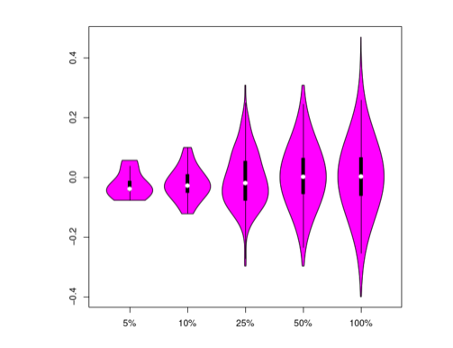
How to know if your data is strand specific
-Trinity has a program that allows you to analysis the data for strandedness
-map the reads to an assembled transcriptome
-run examine_strand_specificity.pl
-will produce
-data file
#transcript plus_strand minus_strand total_reads diff_ratio
TRINITY_DN1_c0_g1_i4 23756 5 23761 1.000
TRINITY_DN1_c0_g1_i1 19240 0 19240 1.000
TRINITY_DN1427_c0_g1_i1 2 3749 3751 -0.999
-pdf of violin plots indicating whether the data is stranded or not
Strand specific but
assembled as non-strand-specific
Strand-specific and
assembled as strand specific
Non-strand-specific

Slide 9
Running out of memory (and time)
-usually a function of having an abundance of reads
-remove contaminants like rRNA to reduce size and data sets
-increase the number of CPUS
-some parts of the process more open to parallel processing
-Trinity (butterfly, last stage)
-normalize the data
-will ignore/throw away error filled sequences
-be careful it doesn’t throw away too much data
-will ignore reads that add to coverage above a defined threshold (Trinity default 50)
-overlap the reads
-reduce the redundancy
-set Trinity option -min_kmer_cov to 2
-Error-containing kmers will be greatly enriched within the low-abundance kmer counts
-might result in more fragmentation of the contigs
NB: when mapping to the generated transcriptome you should use all the reads.

Slide 10
Removal of “contaminants”
Sources of contamination
-rRNA (significant, even after rRNA depletion)
-transcripts you don’t care about
-species you don’t care about
When to remove?
-at the read stage
-reduce the read numbers = reduced computational power and time
-at the contig stage

Slide 11
Bioinformatic removal
-map all the reads to a database of unwanted sequences
--rRNA (significant, even after rRNA depletion)
-https://ftp.ncbi.nlm.nih.gov/blast/db/
SSU_eukaryote_rRNA.tar.gz
LSU_eukaryote_rRNA.tar.gz
LSU_prokaryote_rRNA.tar.gz
16S_ribosomal_RNA.tar.gz
-human genome
-specific unwanted sequences/genomes
-just keep the reads that didn’t map
-eg hisat2 option --un-conc
-eg STAR --outReadsUnmapped
-remove reads based on the mapping results
-if the unwanted sequences are not 100% known may need to adjust the parameters
-specialized software for classification
-Kraken http://ccb.jhu.edu/software/kraken/
-can be done after assembly

Slide 12
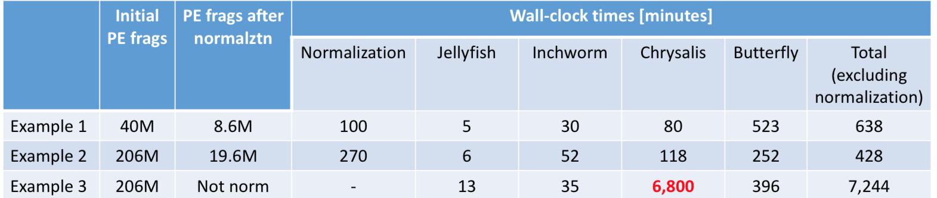
Normalization (Trinity example)
Chrysalis
-overlaps inchworm contigs
-builds graphs for each cluster
-partitions reads between clusters

Slide 13
Overlap/stitch together the reads
-dependent on length of reads and inserts sequenced
-if inserts on average 900 bps and reads 150 bps each NO
-if inserts on average 250 bps and reads 150 bps each YES
-if appropriate lengths
-will generate single reads
-will probably generate separate files of non-overlapped reads
-some assembly programs can’t take mixed reads of singles and paired ends
-some assembly programs have option flags for single reads and paired reads
-programs for overlapping reads
-PEAR
-NGmerge
-fastq-join
R1- 150 bps
R2-150 bps
Insert -900 bps
No overlap -don’t bother
R2-150 bps
R1-150 bps
Insert-250 bps
50 bp overlap

Slide 14
Reduce the redundancy
-more severe than normalization
-usually a set of unique reads
-some may not handle single-end and/or paired-end data
-some are not memory optimized
-most tend to be older programs when datasets were smaller
Software
SeqCluster
FastUniq
FASTX-Toolkit
Super Deduper
ParDRe
BioSeqZip

Slide 15
Miscellaneous points to ponder
-to maximize the number of genes
-use all the reads from all conditions
-programs may allow you to use gzipped files (saves space and time unzipping)
-paired-end libraries
-left=R1=1
-right=R2=2
-don’t forget about the singletons
-during cleanup some pairs may be split with one half being discarded
-preprocessing pipelines usually allow you to capture the singletons
-assembler may allow you to use the singletons and PE
-can treat all reads as singletons
-lose some of the power of being paired
-transcriptomes from gene dense genomes can be problematic
-overlapping genes
-strand-specific protocols may help
-jaccard clip options may help (time consuming X2)
-based on measuring the extent and type of overlap

Slide 16
-deep sequencing (ie. lots and lots of reads)
-increases number of sequencing errors
-increases number of false transcripts
-”isoforms” that are not real
-increases the complexity of assembly (so many choices)
-normalization (kmer based)
-use a higher kmer value
-Memory needed: 1GB of RAM per 1 million reads
-Timing: ½ - 1 hours per 1 million reads (does not include trimming or normalization)
-some assemblers have built in trimming/quality steps (Trinity –trimmomatic)
-reference based methods are much less sensitive to issues of too many reads introducing sequencing errors

Slide 17
Questions?
I invite you to attend the next ICG journal club
Tuesday, Dec 14. 1-2 pm
Stay tuned for the 2022 Tips and Tricks Schedule
A recording of this session will be available from
https://perun.biochem.dal.ca/downloads/icgvideo/TAT/
A copy of this presentation will be available from
https://perun.biochem.dal.ca/user-wiki/doku.php?id=start

